Slide 1

Notes:
In the movie, Encanto, Mirabel is part of the Madrigal family, a magical family where everyone is given a special gift as a child – things like super strength or shape-shifting or healing abilities and so forth. But Mirabel is different. When it’s her time, she’s not given a gift. She’s different from everyone else in the family and it makes her feel powerless, unimportant and overlooked, makes her feel like she can’t shine in the way the other family members do; and she’s waiting on a miracle, waiting to be blessed. But as the story goes on, we see that her difference actually enables her to see and expose things the family doesn’t see. She sees the cracks and brokenness forming in their magical house and she reaches out to those who are misunderstood (we won’t talk about Bruno), and she reveals truth to the family even though they don’t want to listen at first. And it’s her difference that ends up bringing the family to a place of healing and renewal.

Slide 2
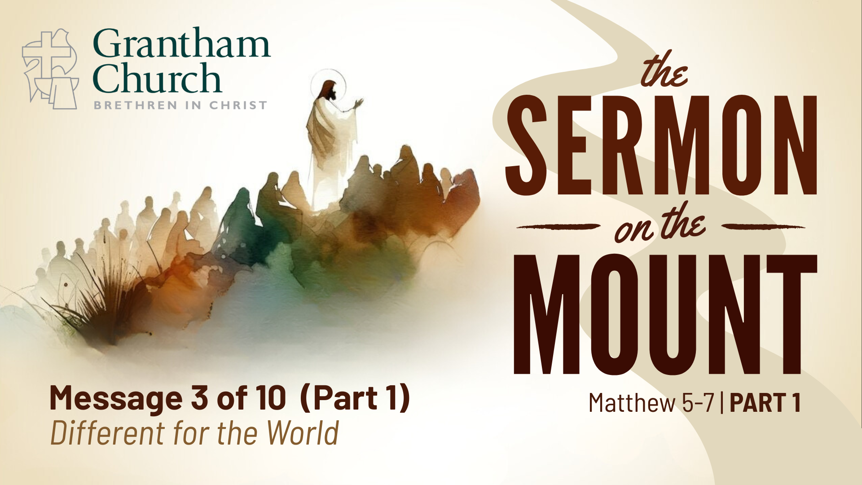
Notes:
We’re in the early weeks of going through Jesus’ Sermon on the Mount in Matthew 5-7 where Jesus outlines for his followers what it looks like to live as his people, transformed by his grace, and participating in his Kingdom work. And right from the start we see that the people of God, those blessed by God, are different from what society would outline as blessed. Last week in the first several verses of chapter 5, called the beatitudes, we saw that those who Jesus says are living the good life are, like Mirabel, those who are powerless, those who are lowly and unimportant, those grieving over brokenness in the world and desiring for people to be in right relationship with God and one another; it’s those who are generous and have pure motives and those who pursue peace and who may be persecuted or insulted or misunderstood because of this. It’s these who Jesus says are living the good life. Because these are the ones who will receive the blessings of God – both now and in eternity – blessings of comfort, fulfillment, mercy, and the very presence of God.
And those listening to Jesus’ teaching hear this as good news, because they are the powerless: the outcasts, the downtrodden, the sick, the uneducated and they’re hearing that they are actually the ones God is blessing, because they recognize their need for God. But, as Jesus goes on and we look today at salt and light – which is still part of this first section of the sermon on Kingdom Identity - we’re going to discover that the difference in Jesus’ followers has a purpose. We’re different from the world, but we’re different for the world; for the sake of the world. Our difference is what causes us to make an impact in the world.
And Jesus uses three metaphors for what this difference is supposed to look like: salt, light, and a city – and light and city are really communicated as one concept so we’ll think about them together. These metaphors of salt and light show us why disciples of Jesus are different; for what purpose.
So today, we’re going to look at 1) these two metaphors for how believers make an impact in the world, and 2) we’ll look at the warnings associated with them, and finally 3) we’ll consider what gives us the ability to live in this way, to make an impact.

Slide 3
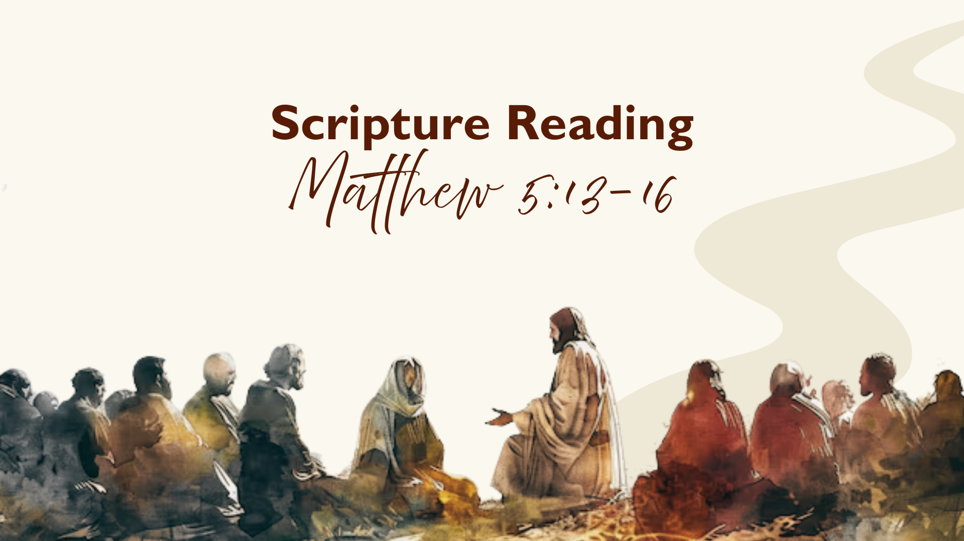
Notes:
So, let’s look at these metaphors of salt and light. And let’s just notice that these are ordinary, everyday things. They’re absolutely basic to life. They’re common elements that every person would have and be familiar with. And they’re also two elements that assume a recipient. You put salt on food. You shine light on something else. There’s something/someone benefiting from the salt and the light.
Let’s look at SALT
v. 13 “you are the salt of the earth” – what is Jesus saying here?
Well, we know salt today primarily as something that adds or enhances flavor. There’s a book and documentary on Netflix with the chef Samin Nosrat (sameen nohsraht) who talks about salt as one of the basic elements of good cooking and she says how salt can even make food taste more like itself. Isn’t that an interesting idea – are we as followers of Jesus supposed to make the earth be more of what it’s intended to be; to restore it to how God created it. I think we might be moving toward the intention here.
In the ancient world, the most pervasive and ordinary use of salt was as a preservative. Back in the day there was no refrigeration, so people used salt to preserve food. You’d cover meat and foods with salt to keep them fresh and help them last a long time. So, the idea behind God’s people being salt is that we are preservatives. We recognize where there’s a tendency to decay and we go into those spaces to stop it or slow it down.
It's easy to see that the fallen world around us has a tendency toward decay. We’ve seen plenty of that the last few weeks – the breakdown of society on the individual and structural levels. We see this in our everyday lives – with increased isolation and upticks in mental health issues and disagreements in or about our schools, people being marginalized, etc. We could go on and on to see so many ways the world is decaying.
And what Jesus says is that his people are the salt. We are to go to those places tending toward decay and prevent them from going bad. To bring goodness and healing and hope.
CHRISTINA STORY
I was talking this week with Christina Weber, member at Grantham, (not here today).
Life in many ways is an example of being salty and bringing life and good into tough situations. Specifically she was telling me about her work as part of a Youth Aid Panel, which is an initiative through the Cumberland County juvenile probation office. Their goal is restorative justice. And what she does as part of this panel is she meets with first time juvenile offenders of nonviolent crime. She talks with these young people and finds out who they are and what they like and what their future plans are. And the panel works together to find creative ways for the youth to benefit society that might also express who they are or use their interests. They also help the youth understand how what they’ve done impacts the community as a whole.
-And Christina shared that many of our systems are not set up to benefit children. And she sees these broken systems as places of decay, but she’s willing to rub herself in – so to speak – to be the salt that brings preservation, that guards against further break down and brings healing.
Maybe for you there’s a place you’re noticing is moving toward decay. I remember talking with a college student a few years ago who was getting ready to graduate and go into teaching. And when she was doing her student teaching she noticed that the break room was a place of decay. A lot of the teachers would come into the break room and just complain about the kids in their class or the administration or whatever it was. And she recognized there were some true issues there, but she wanted to be salt, an uplifting voice who would speak life and encouragement into that room….it takes a lot of wisdom and nuance and grace and humility…but that’s being salt.
And sometimes we can see the decay in the world and we can either spiral into despair – “there’s no use in doing anything because it’s just too far gone” – or we can blame the world – “What’s wrong with people. If we just had better systems. If we just had better laws or better schools or more wholesome entertainment.” And we can sit by with each other bemoaning the state of the world, when what should we expect? If you see a steak sitting on the counter for 5 days and it starts getting stinky and turning weird colors you don’t say “what’s wrong with that steak?” John Stott has an amazing quote in his commentary Christian Counter-Culture (p.65):

Slide 4
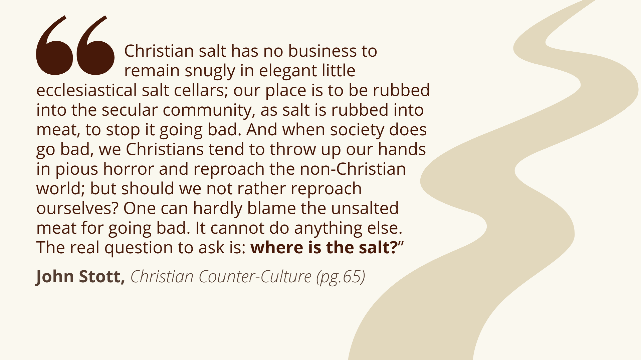
Notes:
READ
Where’s the salt? When we see kids being taken advantage of or we learn about the unfair processes or we experience people creating atmospheres of negativity, the question is where’s the church? Where’s the salt? Where are we noticing decay around us and how is God inviting us to move into those space to bring life and healing?

Slide 5
Notes:
Let’s look now at LIGHT
v. 14 “You are the light of the world” – In Scripture, light is often depicting the presence of God. It also refers to the teaching of God or God’s wisdom (Psalms: Your word is a lamp to my feet and light to my path). And we get this in modern-day language too. We say we are “enlightened” when we learn something or when we have a good idea, the “lightbulb” comes on. So, being the light of the world has to do with bringing wisdom and insight from God. To be the extension of God’s presence. To illuminate what is good and true.
And in verse 16, Jesus equates being the light with doing good works: “let your light shine before others, that they may see your good deeds and glorify your Father in heaven.” And the concept here of good deeds is really about doing acts of righteousness, justice, and peace. And this will be unpacked more throughout the sermon on the mount (we saw in beatitudes hunger for righteousness, pursuit of peace).
So, what does it look like to be light in the world? It means bringing wisdom and truth into situations. Being a restorer of justice and peace.
So, that could look like carefully and humbly shining light on a hard reality within your family – helping your loved ones to see patterns of brokenness.
It could look like choosing not to give in to unethical practices at work, even if it means losing respect or status or even your job.
It could look like being a countercultural presence among your friends. Practicing contentment with what you have. Prioritizing rest. Using your time to serve others.
This can look a thousand different ways. And often, we think we’ll shine the brightest light when we use our successes and strengths to help others (and God can use that, for sure). But, light finds a way through darkness, doesn’t it? Often God will use our failures and weaknesses to meet people in their dark places, just as he’s met us in ours. So, if you’re wondering how to be a light in the world, consider where you’ve felt weakest and like a failure - where God has met you in your brokenness and need with his grace - and see how God might want to use that to point others to him.
As lights, we shine on Jesus, the ultimate light of the world (which Jesus calls himself in John 8:12). We extend his light and presence. The Scripture says that as our light shines, others will see our good deeds and glorify our Father in heaven. They won’t look at us and say “wow, you’re such a great person”, but hopefully, they’ll look at God and say “wow, what a great God.” And we need to help people connect those dots sometimes. We need to use our words, too, to help others see how Jesus has transformed us and empowered us to do good. So, being a light includes good deeds and good words that help others to see the beauty of God.
And I want us to notice something here about these verses “you are the salt of the earth and you are the light of the world” – the verb, you are:
It’s a statement of reality – this is a God-given identity. Those who are described in the beatitudes, those who recognize their need for God and are longing for restoration in the world – these people are salt and light. It’s not something we strive to be or try to attain, it’s a God-given identity. So, Jesus is basically saying “be who you are. This is who you are.”
Plural – You Plural. That means we together are salt and light. Yes, as individuals we are, too, but we together as God’s people bring healing and justice and hope to the world. LIANNA STORY – I have a friend in MA who, several years ago, felt led by God to begin fostering a child. She’s a single woman and for a while she felt she shouldn’t do that, but then God spoke to her and helped her realize that she’s part of a community of faith who would walk with her and help her raise a child. And when she took in the child she would be fostering and eventually adopting, she had to move into a new house and church helped her move and clean and set up the house – and they also came around her to shower her for the new baby she was taking in. The church set up a wraparound care team who committed to be regular parts of her life – to pray for her and the child and the situation and make her a meal every week, to help with transportation and get trained to give respite childcare. She’s said she could never have done it on her own. It was only through being part of a people transformed by God and pursuing justice and healing in the world that she/they could be salt and light in that little girl’s life and in that whole situation and throughout the foster system.
And these stories we hear can sound really extravagant, right? “I don’t think I can take in a child” or we hear about the heroes of the faith who make major impact in the world, like Deitrich Boenhoeffer or William Wilberforce or Julia Johnson and we think “I can’t be like that” or we feel powerless to contribute to change. But that’s kind of the point. We are powerless. We are the poor in spirit, the meek and downtrodden. But we are blessed by God. Salt and light are ordinary items, but you don’t need much of either to make an impact. Our source is Jesus Christ. He's the one who brings the deep and lasting transformation. He just uses us. He is the one who blesses us so we can bless others.
And I do think there are some practical ways we can lean into this reality that we are salt and light. Not long ago I came across this paradigm called BLESS, created by brothers and pastors Jon and Dave Ferguson, which I’ve found really helpful in practically approaching being salt and light in the world. And you may have already heard or seen this, but it’s a memorable way to think about how we – as blessed followers of Jesus – can bless others:

Slide 6
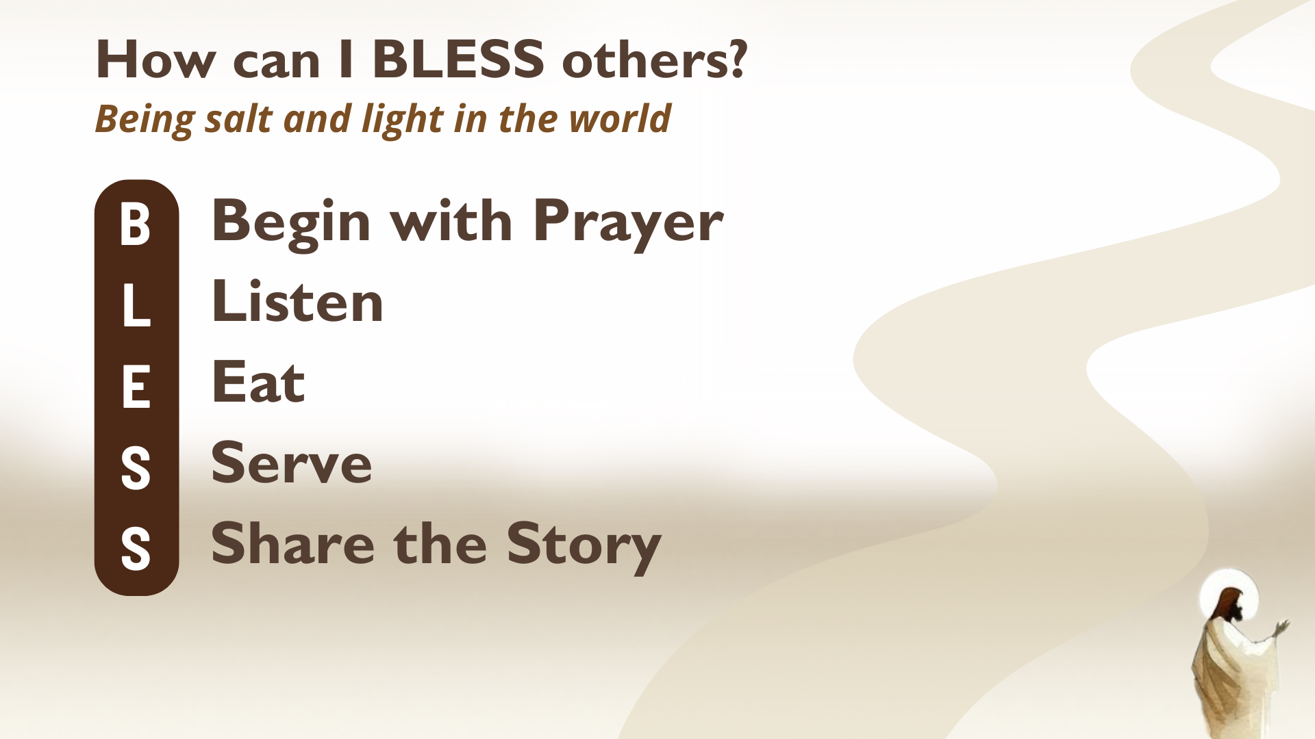
Notes:
B - It all begins with a heart surrendered to God. Asking God to open our eyes to what and who is around us. To burden us for what is broken. To guide us into the dark places that are prone to decay. God will hear and answer those prayers
L – listening has to do with asking questions of others (of God, too), listening for their needs, their struggles, hopes, and fears and learning what drives them and where they feel lost.
E – eating is something we all do and we probably don’t do it together often enough. As we listen to our friends and learn who they are, we can invite them to our tables. We can be vulnerable and welcome people into our space and open opportunities to share life. To build trust so we have opportunity to bring wisdom and goodness.
S – serve: as we spend time with our neighbors and friends and learn about their longings or potential decay in their lives, God will show us how we can help meet their needs, how we can reach out to others to help serve.
S – share the story. And this isn’t always a linear process, but we can be listening for God to show us when and how we can share our experience of receiving God’s light and share the hope of Jesus as the one who can bring light into their darkness.
And with this whole BLESS paradigm – as much as we can do any of it together is good and I think just multiplies our capacity to be a blessing. Remember, we together are salt and light, so if there are ways we can come together in prayer and eating and serving and so forth, that’s how our neighbors will experience a community of people who are different from them, but who are completely for them. Who want them to experience the good life. So, maybe God is putting someone on your heart right now within our congregation or another believer you know and maybe you could reach out to them to ask “hey, could we talk about how we could bless our neighbors together?”

Slide 7
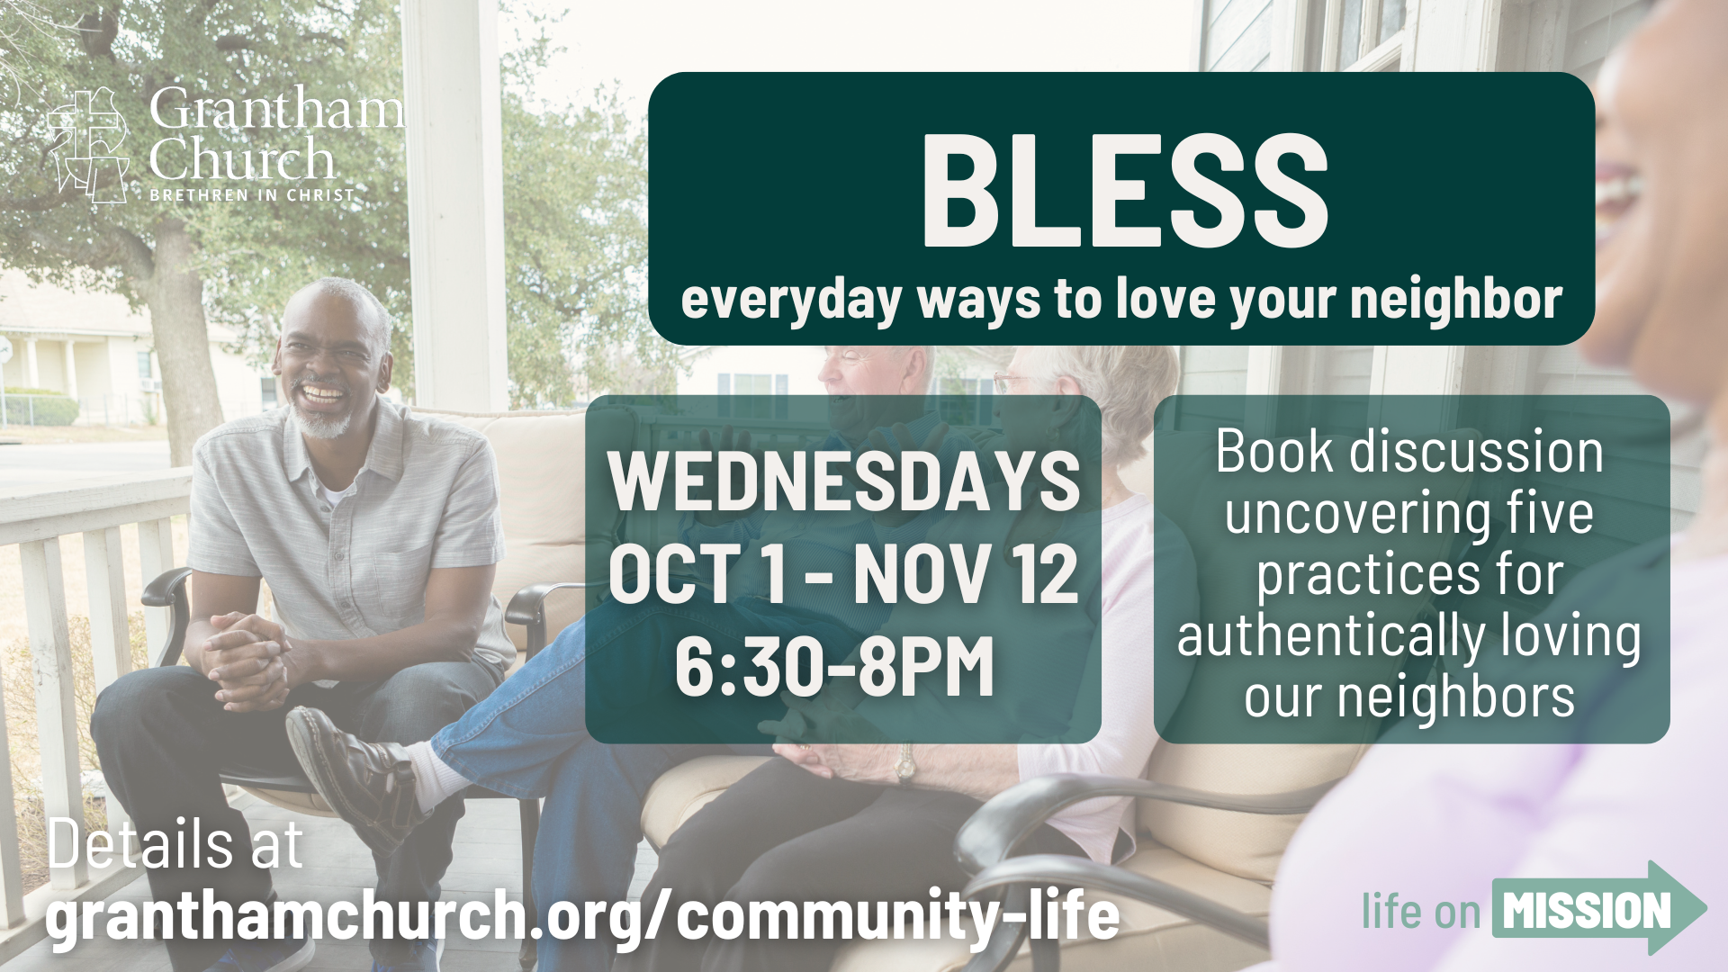
Notes:
I will mention that we have a discussion group starting on Oct 1 that will be diving deeper into this BLESS paradigm. There’s a book they’ll be using as their guide. So, if you want to grapple more with this and start practicing it with the help of others, join the 7-week Wednesday night series starting soon.

Slide 8
Notes:
So, salt and light help us understand how we as followers of Jesus make an impact in the world – to bring healing where there is decay; to bring wisdom and the presence of God into dark situations. But before we consider the power we have for living this way, we need to notice the warnings in these verses.
READ vv. 13-15
Jesus is helping his followers think about how they could cease being salt and light. And there are two traps we could fall into.
If we lose our saltiness, it means we’re losing our ability to preserve. We’re losing our distinctness, the very thing that makes us uniquely able to be agents of protection and renewal. (And Jesus’ words are strong here – basically, that’s useless, not good for anything except to be thrown out)
If we hide our light it means we’re losing our presence. We’re not engaged where we are supposed to be engaged. We can’t bring wisdom and truth if we’re not there.
Dick Keyes in his book Chameleon Christianity uses an analogy to help us think about this. He talks about chameleons and musk oxen. Two very different animals.

Slide 9
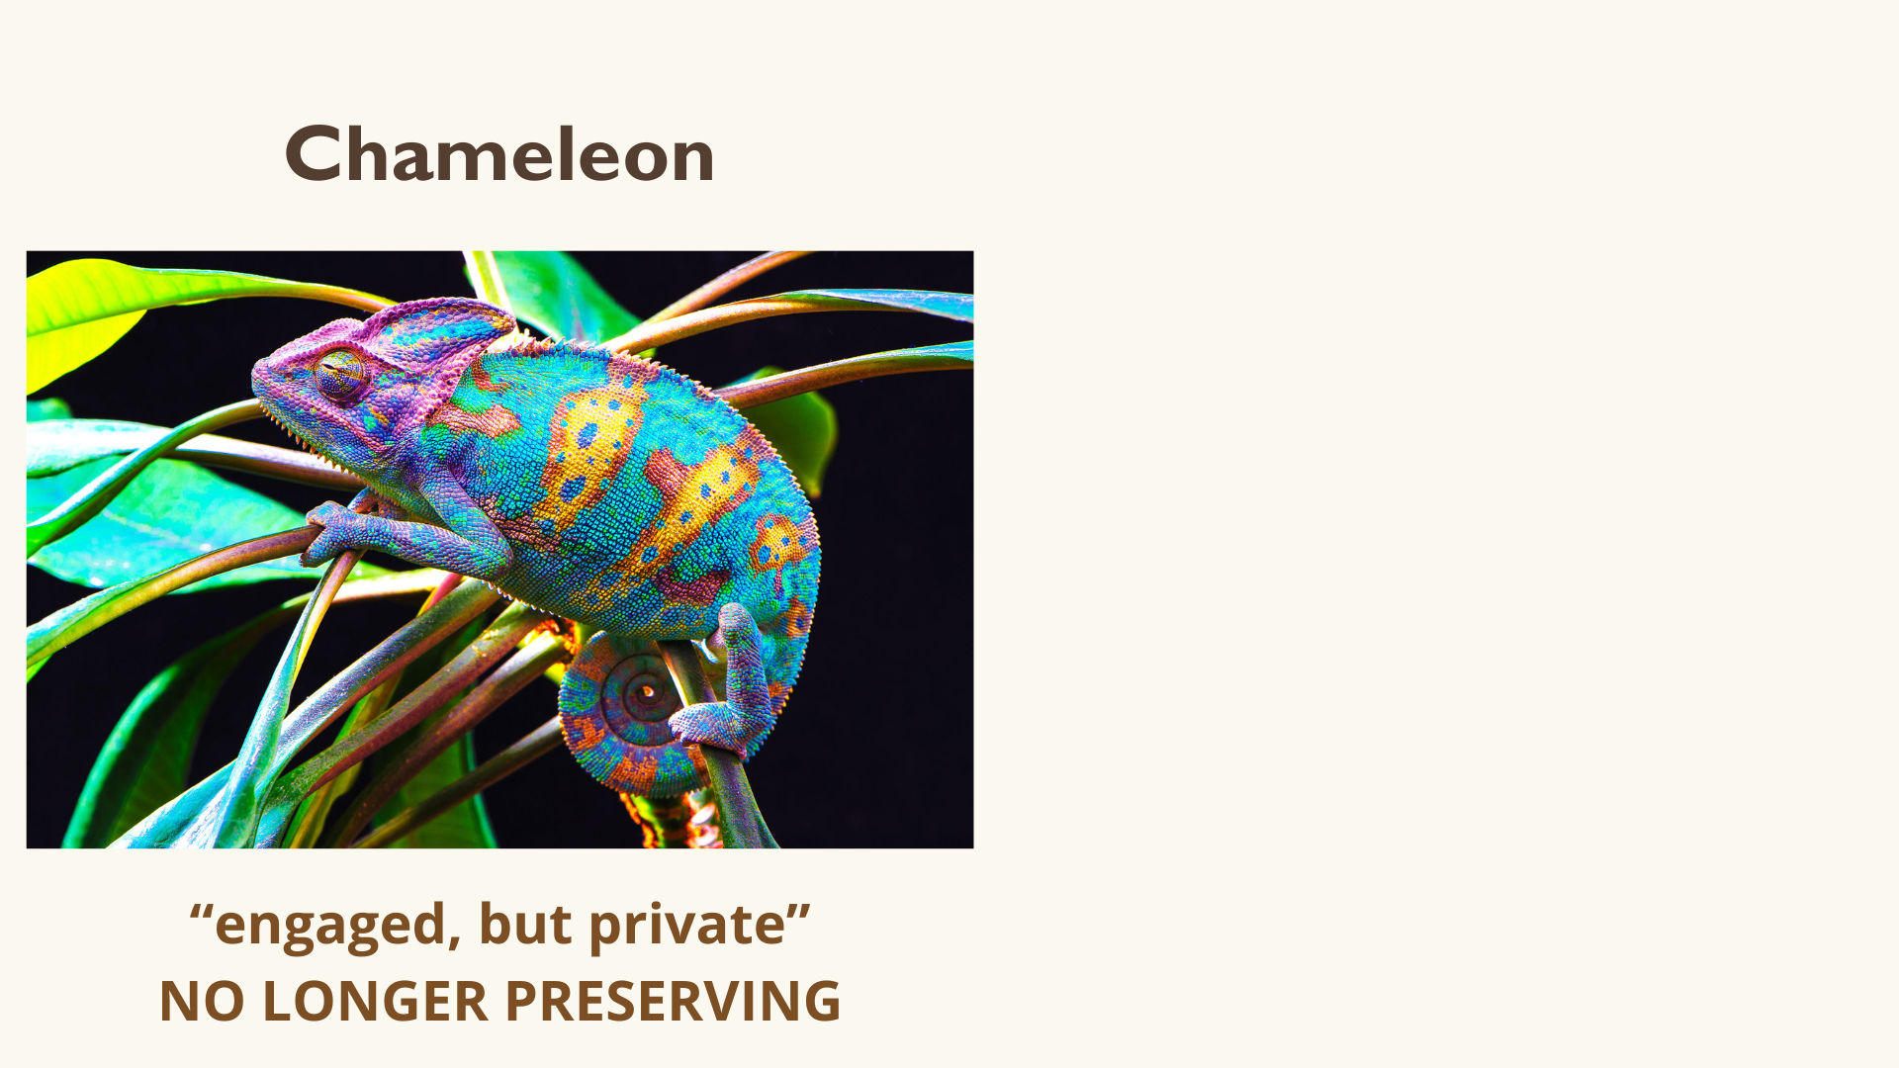
Notes:
Chameleon – changes its colors to blend in with the environment. So, this would be like the Christian who is engaged in the world, but private about their faith. They adapt to the society, but to such an extent that they lose their distinctiveness. They’re no longer able to challenge or help the culture where needed, because they’re too similar to it. Imagine telling a friend that you’re a Christian and they’re like “oh, really?! Wow, I had no idea!” The chameleon Christian might have a lot of non-Christian friends, might be engaged in a society at various levels – maybe on the school committees or they’re volunteering with the nonprofits, playing in the band, they’re known in their neighborhood, but maybe don’t really talk about their faith or their Christian practices and don’t help others see how they’re different. Maybe they’re even giving in to the pressures of the world to gossip or to feed divisiveness or to pursue financial gain at all costs or to make sports an idol in your life. The chameleons have lost their saltiness.

Slide 10
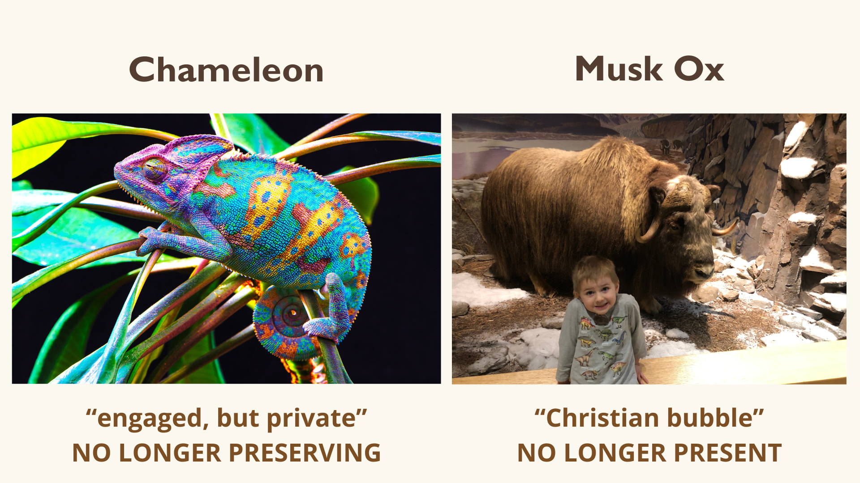
Notes:
(but the other danger is…) Musk Ox – I don’t know a whole lot…I’ve seen a taxidermized one at Messiah’s Oakes Museum next door (pic). From what I understand, musk oxen (arctic animals) do this thing when they feel threatened. They circle up around their young with their horns facing outward to protect themselves and their young and ward of outsiders. So, this is like the Christian who’s in a bubble. Who’s not connected to the world or engaging meaningfully with non-believers (maybe even hostile toward them). It’s the Christians whose only friends are other Christians. Whose only activities are church activities. Who are only connected to Christian organizations. And they may be different. They may have unique Biblically-driven values and would even verbalize those values if needed, but they’re only shining within the confines of a bowl. They’re hiding their light. They have no relevance to the world, because they’re not integrated into it.
So, these are the warnings, not to lose our presence and influence in the world and not to lose our preservation ability. We’re supposed to be a counterculture for the common good.
And none of us completely falls into one or the other of these categories, but it’s good for us to think about which trap we tend to fall into and what’s a step you could take in moving more the other way.
Christian bubble (musk ox)…asking God and noticing who’s in your life who’s not a follower of Jesus and how could you move into relationship with that person. Maybe it’s starting to frequent a local café or shop where you could meet folks or joining a class at the gym or visiting the local library. Maybe it means shifting your schedule your routines a bit.
Engaged, but private (chameleon)…when your friends ask what you did this weekend, you could say you went to church and how you’re learning this stuff that’s really helping you…and thinking about how Christians are supposed to be different, but good for the world, and you’re wondering am I really like that? Is that the reputation the church has?
So, let’s heed these warnings of Jesus and recognize which traps we tend to fall into.

Slide 11
Notes:
But, we also need to recognize that we can’t make ourselves more salty and make ourselves brighter. I think many of us want to live in this way where we’re different for the good of others. But it’s only Jesus who enables us to be like that. And as we lean into Jesus and love him and seek to model our lives after him, we’ll find ourselves becoming more like him.
Jesus is completely different from the world. He never had an impure thought, a mixed motive, a bad attitude. Yet his heart was always for the world. And he was always found in the places that were contaminated. He touches the lepers. He eats with the sinners in their homes. He was drawn to the darkness and decay, but he always brought healing and light. And his holiness – this separate quality about him – is what compelled him into the world. And his holiness was contagious.
In the Old Testament we read about God’s people, Israel, who were set apart to be holy. They were supposed to be different for the world. And God’s covenant with Israel actually involved salt. Their offerings/sacrifices were supposed to be salted. We read about this in the OT laws (Lev 2:13) and the covenant is sometimes called a “covenant of salt”, meaning God’s people were supposed to be the ones who would bring long-lasting preservation to the world by preserving the covenant promises. And we also read throughout the OT that God’s covenant people, Israel, were supposed to be a light to the nations, so the nations would see God. But, what happened? Israel violated the covenant. They lost their saltiness. They hid their light. So they were trampled on, exiled, by other nations.
But Jesus himself then becomes the light. He establishes a new covenant and makes a new people through his blood shed on the cross. So in preaching “you are the salt of the earth and you are the light of the world” Jesus is telling his followers that he’s building his new city right here – Jerusalem was the heavenly city on a hill who was supposed to shine light to the nations – God was beginning to build his new Jerusalem, a new city right then and there. With that ragtag group of followers. And we’re part of that group. He’s continuing with us. He blesses the powerless to be the ones through whom the world will experience God’s presence and restoration as we carry out his good works.
(Thanks be to God!)

Slide 12
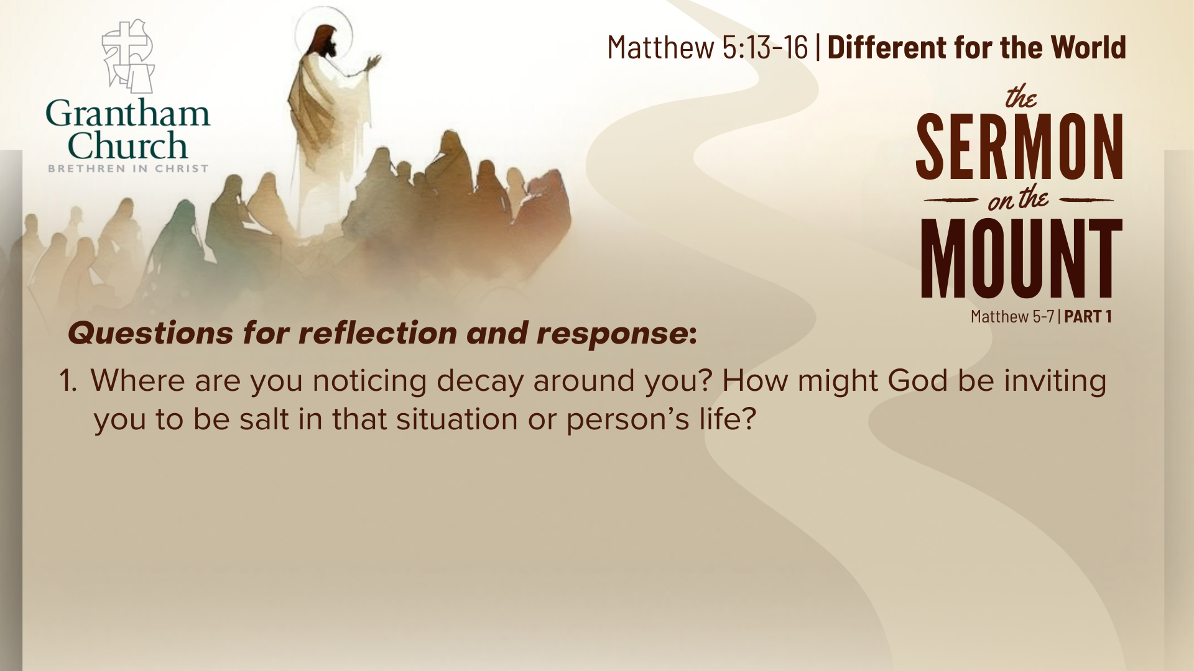

Slide 13
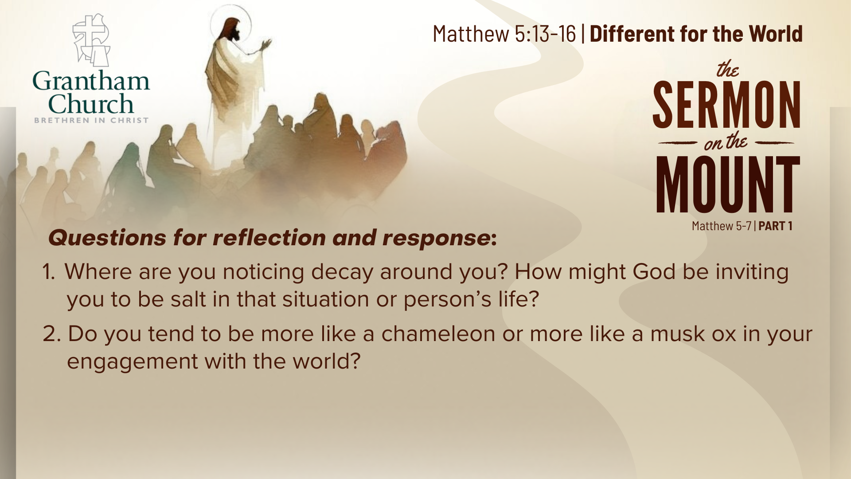

Slide 14
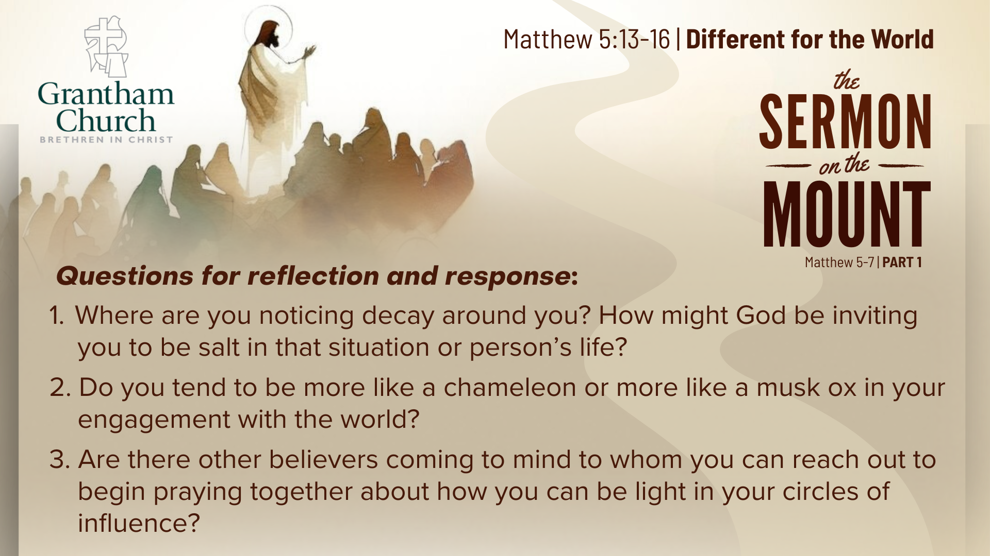

Slide 15
